Slide 1
Chap 2: Data types, Operators and Expressions
Lecture 1: Data types-2

Slide 2
Character type
Character (char) type represents a single character, including those that can be typed-in.
char app=‘a’, abc=‘B’;
Size: characters are usually stored in 8 bits (one byte) of internal storage.
Values: integers 0~255 (-128~127), and the ASCII table gives the correspondence between letters and integer values.
ASCII stands for American Standard Code for Information Interchange.
http://www.asciitable.com/
Printf(“%c\n”, app); a
Printf(“%d\n”, app); 97
App : 010101001

Slide 3
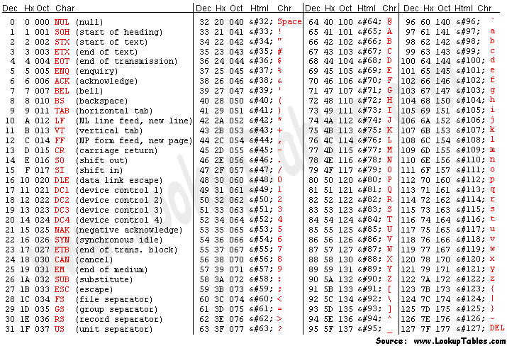
Notes:
ASCII stands for American Standard Code for Information Interchange. Computers can only understand numbers, so an ASCII code is the numerical representation of a character such as 'a' or '@' or an action of some sort. ASCII was developed a long time ago and now the non-printing characters are rarely used for their original purpose.

Slide 4
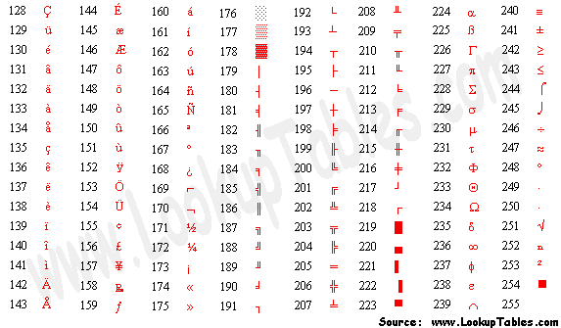

Slide 5
Black slash characters
C supports some special backslash character constants that are used in constant declarations and output functions.
\a bell \v vertical tab
\b back space \’ single quotes
\f form feed \” double quotes
\n new line \? question mark
\r carriage return \\ backslash
\t horizontal tab \0 null
These characters combinations are known as escape sequences.

Slide 6
Characters and their values
An example (characters.c)
#include<stdio.h>
int main()
{
char c1, c2;
c1 = 'x';
c2 = 121;
printf("%c %c\n", c1,c2); /*Display characters*/
printf("%d %d\n",c1,c2); /*Display ASCII values*/
printf(“%c %c\n”,c1-32, c2-32); /*Convert to upper case*/
printf("%d %d\n",c1-32, c2-32); /*ASCII values*/
return 0;
}
What if this difference is unknown?

Slide 7
Type | Storage size | Value range
char | 1 byte | -128 to 127 or 0 to 255
unsigned char | 1 byte | 0 to 255
signed char | 1 byte | -128 to 127
int | 2 or 4 bytes | -32,768 to 32,767 or -2,147,483,648 to 2,147,483,647
unsigned int | 2 or 4 bytes | 0 to 65,535 or 0 to 4,294,967,295
short | 2 bytes | -32,768 to 32,767
unsigned short | 2 bytes | 0 to 65,535
long | 8 bytes | -9223372036854775808 to 9223372036854775807
unsigned long | 8 bytes | 0 to 18446744073709551615

Slide 8
To get the exact size of a type or a variable on a particular platform, you can use the sizeof operator.
The expressions sizeof(type) yields the storage size of the object or type in bytes.
#include<stdio.h>
int main()
{
printf("%d\n", sizeof(int) );
printf("%d\n", sizeof(long) );
return 0;
}

Slide 9
Floating point types
Fractions in binary
1/3 = .010101... means
1/3 = 0 × 2⁻¹ + 1 × 2⁻² + 0 × 2⁻³ + 1 × 2⁻⁴ + ...
= 0.3125 + ...
An exact value cannot be found with a summation of a finite number of inverse powers of two.
 | float | double | long double
Bytes | 4B (32b) | 8B (64b) | 16B
Limit | ±3.4×10³⁸ | ±1.8×10³⁰⁸ | ±1.2×10⁴⁹³²
Precision | 6～7 | 15~16 | 1８~1９
Number of significant digits
Notes:
The following table provide the details of standard floating-point types with storage sizes and value ranges and their precision −

Slide 10
Round-off error of floating numbers
An example (roundoff.c)
f=0. 98765433,
d= 123456789.98765433
#include<stdio.h>
int main()
{
float f;
double d;
f = 0.987654321f;
d = 123456789.987654321;
printf("f = %.8f,\nd = %.2f\n", f, d); return 0;
}
What would happen if we add or subtract a very small number from a large one?

Slide 11
Type width/size comparison
char(1)
short(2)
int (4)
Wider
long int (4) or (8)
float(4)
Double(8)
long double(16)

Slide 12
Variables
Mathematical definition
A symbol that represents a quantity likely to vary (change).
A variable in C programming
Is a name that may be used to store a value. (be associated with a computer memory block)
Takes different values at different times during execution.
Subjects to the rules for identifiers
Examples: Valid? Invalid?
John Value T_raise Delphi x1
ph_value mark sum1 distance
123 (area) % 25th
name
value
type

Slide 13
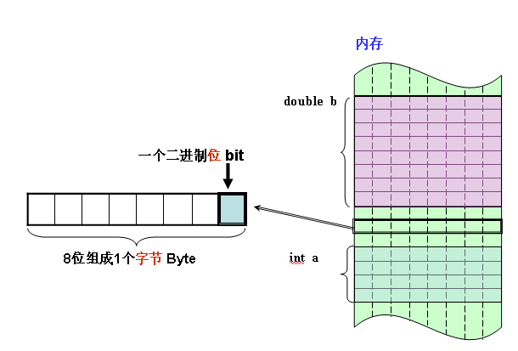
Variables
Storage of variables
A variable is the name of a memory block (not the address)
The size of the memory block (variable) is determined by the type.
Bit (the smallest unit or cell in computers, 0 or 1)
Byte (8 bits)
Word (several bytes dependent on machines, e.g., 8 bytes in a 64-bit system)
1word=8bytes=64 bits

Slide 14
Variables
Declaration to tell the compiler (system):
the size of memory to be allocated
the name, and
the initialized value
Syntax
data-type v1,v2,…,vn;
Examples
int count;
Char a;
int number, total;
Values are initialized by the compiler as random numbers (trash values)
or a specified dumb value (0xCCCC).

Slide 15
Variables
Initialization
Tips (recommended by not required):
Choose meaningful names that give the purpose of the variable
Use short name for local variables (within a function or an embraced block), especially loop indices.
Use longer name for external variables, which are shared by multiple functions or source files.
int counter = 15;

Slide 16
Declaration of variables in a program
main()/*………………………Program name………………………………*/
{
/*………………………Declaration………………………………*/
float x, y;
int code;
short int count;
double deviation;
unsigned n;
char c;
long int amount;
…………
/*………………………Computation………………………………*/
……………………
………… ……………………
} /*………………………Computation………………………………*/
All variables must be declared in the beginning of a function!

Slide 17
Variables
Value assignment, i.e., changing the value of a variable
value = amount + inrate * amount;
Target variable
Syntax
variable_name = constant / expression;
Example
initial_value = 0;
final_value = 100;
balance = 75.84;
yes = ‘x’;
Initialization
data-type variable_name = constant;
Example
int final_value = 100;
double balance = 75.84;
char yes = ‘x’;

Slide 18
Variables
Assignments ‘=‘ V.S. mathematical equals ‘=‘
How to swap two numbers?
How to swap two numbers without using a temporary variable but operators ‘+’ and ‘-’?
int x = 12, y = 2;
int temp=0;
temp = x;
x = y;
y = temp;
int x = 1, y = 2;

Slide 19
Constants
Not changeable
Computers do NOT allocate writable memory
Use them ‘as is’, e.g., 1, 1.0, ‘a’
(LITERAL) CONSTANTS
Numeric constants
Character constants
Integer constants
1, 1L
Real constants
5.4, 5.6f, 5.9L
Single character constants
‘A’, ‘B’, ‘a’, ‘\n’
String constants
“Xin Fan”

Slide 20
Integer Constants
An integer constant refers to a sequence of digits. There are three forms of representation:
Decimal integers: Consist of a set of digits, 0 through 9, preceded by an optional – or + sign.
Example: 123 -321 0 654321 +78
Octal integers: Consist of any combination of digits from the set 0 through 7, with a leading 0.
Example: 037 0 0435 0771
Hexadecimal integers: A sequence of digits from the set 0 through 9 and A through F preceded by 0x or 0X.
Examples: 0X2 0x9F 0Xbcd
Integer suffix: L or l stands for ‘long int’, U or u for ‘unsigned’, and the combination ‘UL’ or ‘ul’
Examples: 9876543L or 9876543l, 56789U or 56789u ,
56789U or 56789u
7×8²＋ 7×8¹＋1×8⁰ = 505
11×16²＋ 12×16¹＋13×16⁰ =3216
Notes:
Capital L is recommended
Hexadecimal[ˌheksəˈdesɪml]

Slide 21
Real Constants
Decimal notation
Examples: 0.0083 -0.75 435.36 +247.0 215. .95 -.70 +.5
Exponential [ˌekspəˈnenʃl] notation—— a E(e) n （a*10^{n} ）
Examples: 0.65e4 12e-2 1.5e+5 3.18E3 -1.2E-1
Real suffixes:
F or f —— float
L or l —— long double
Tips for integer and real constants
Suffixes are case insensitive, either lower or upper case works
Capitals are recommended, especially for ‘L’.
Why do we use so many forms for integer and real constants?

Slide 22
Default values of constants
Integer constants, by default, represent int type data. We can override this default by specifying unsigned or long after the number (by appending U or L):
Literal Type Value
-222 int -222
45678U unsigned int 45,678
-56789L long int -56,789
987654UL unsigned long int 9,87,654
Real constants, by default represent double type data. We must append the letter f or F for float and l or L for long double:
Literal Type Value
0. double 0.0
.0 double 0.0
12.0 double 12.0
1.234 double 1.234
-1.2f float -1.2
1.234546789L long double 1.23456789

Slide 23
Defining symbolic constants
A symbolic constant is defined as:
#define PASS_MARK 60
#define MAX 200
#define PI 3.14159
A symbolic constant is evaluated during compilation by replacing symbols as constants, and can be used where a constant occur.
int students[MAX];
Defining symbolic constants frees us from the problems:
Problem in modification of the program.
Problem in understanding the program.
#define PI 3.1415926
main()
{
double radius;
scanf(“%lf”, &radius);
printf(“Input readus: %8.2f.\n”, radius);
printf(“The area is:%8.2f”, 2*3.14*radius);
printf(“The perimeter is: %8.2f”, 3.14*radius*radius);
printf(“The area is:%8.2f”, 2*PI*radius);
printf(“The perimeter is: %8.2f”, PI*radius*radius);
}

Slide 24
Rules of defining symbolic constants
Symbolic names have the same form as variable names.
No blank space between the pound sign ‘#’ and the word define is permitted.
‘#’ must be the first character in the line.
A blank space is required between #define and symbolic name and between the symbolic name and the constant.
#define statements must not end with a semicolon.
After definition, the symbolic name should not be assigned any other value within the program by using an assignment statement.
Symbolic names are NOT declared for data types. Its data type depends on the type of constant.
#define statement may appear anywhere in the program but before it is referenced in a program.

Slide 25
E-1
Identify the data type for each of the following constants:
Literal Type
12
0X3
‘C’
2.34E07
‘\040’
7.0
6L
6.0F
012
2.9e05L
‘\n’

Slide 26
Exercise-2
Which data type would you use for each of the following kinds of data:
a. The population of Dalian
b. The cost of an online movie
c. The most common letter in this chapter
d. The number of times that the letter occurs in this chapter

Slide 27
Exercise-3
Correct this silly program:
int main(void)
{
cows, legs, integer;
printf(“How many cow legs did you count?\n”);
scanf(“%c”,legs);
cows = legs / 4;
printf(“That implies there are %f cows.\n”, cows);
}

Slide 28
Homework
Read Chapter 2, Section 7.2 and 7.4 of the KR textbook.
Self-learnning printf（） http://c.biancheng.net/view/159.html
https://www.bilibili.com/video/BV1Bx411u7qY?from=search&seid=12711010823689150651 P9=P14观看
4 In the U.S. system of volume measurement, a pint is 2 cups, a cup is 8 ounces, an ounce is 2 tablespoons, and a tablespoon is 3 teaspoons. Write a program that requests a column in cups and that displays the equivalent volumes in pints, ounces, tablespoons, and teaspoons.

